Slide 1
MSIS 2606 Software Project Management
Project Draft
Aashka Aradhya | Aishwarya Dingre | Megha Prasad | Megha Sharma | Ritika Mathur | Oleksandr Vozniuk | Yue Wu
Notes:
Time: 30 sec
Slide Type: Title
Total Time:112 min
We aim to refine these slides to cut down presentation time to 60 min

Slide 2
Contents
Mission Statement
About StyleUp
Problem Statement
Our Existing System
Business Requirements
Proposed OSS Solution
Why MongoDB?
Why MongoDB suits us better?
MongoDB Architecture
Upstream and Downstream Applications
High-Level System Requirements
Personas
User Stories and Acceptance Tests
SDLC Model
Timeline and Milestones
Key Areas to Focus
Risks and Mitigation
References
Notes:
Time: 30 sec
Slide Type: Transition

Slide 3
Style Up’s Mission Statement
It is our mission to bring our clients the clothes they love by leveraging our personal stylists and combining their expertise with technology, to deliver an affordable styling solution, which adapts to our client’s evolving preferences.
1
Notes:
Time: 30 sec
Slide Type: Transition
References :
1. Mission Statement: https://www.stitchfix.com/about

Slide 4
About Style Up
Notes:
Time: 30 sec
Slide Type: Transition

Slide 5




About StyleUp
What does StyleUp do?
We are a team of 75 and growing as our customer base grew 240% from 500 to 1200 in 10 months
At StyleUp, we are transforming the way people find what they love. Our clients want perfect clothes as per their preferences without the burden or search or having to keep up up with current trends
5
4
3
2
Custom selected clothing delivered to your door
Buy what you like, send back the rest. Shipping is free and easy both ways
Fill out a style profile
Notes:
Time: 1min
Slide Type: Simple
References:
2. Confused Shopper Image: https://bit.ly/2TVZ4gW
3. Survey Image: https://bit.ly/2TWxJv1
4. Delivery Person Image: https://bit.ly/2BH3gKa
5. Happy Shopper Image: https://bit.ly/2EgRecs

Slide 6


How do we do it?
6
Each client fills out a profile upon signup that’s calibrated to get us the most useful data with the least client effort to capture dimensions and style preferences
Rich data on both sides of the market, makes StyleUp a matchmaker, connecting clients with styles they love and never would’ve found on their own
7
Our merchandise is curated from the market, ensuring something for everyone
Notes:
Time: 1min
Slide Type: Simple
References:
6. Brands Image: https://bit.ly/2GvsjUT
7. Diverse Shoppers Image: https://bit.ly/2DUcx1S

Slide 7

Problem Statement: Data we need is changing as we grow
8
We plan to explore a lot of photographic and textual data (unstructured): inventory style photos, Pinterest boards, social media profiles and the vast amount of written feedback and request notes and photographs we receive from clients
Traditionally we curated styles for our customers based on structured data collected from the style profile they filled out on sign up
To sustain our growth, we have to enhance our
value proposition :
Understand to our best ability what our customers like
Notes:
Time: 1min
Slide Type: Simple
References:
8. Growth Image: https://bit.ly/2towo4C

Slide 8
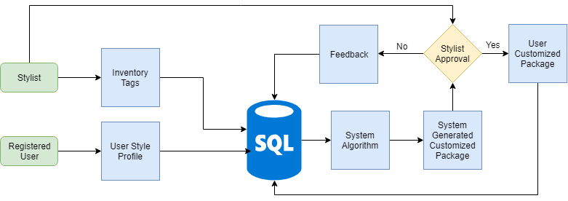
Our Existing System
9
Notes:
Time: 1 min
Slide Type: Simple
References:
9. Existing System Flowchart drawn using: https://www.draw.io/

Slide 9

Challenges we face with MySQL
Unstructured Data
Schema Inflexibility
Scalability
Oracle owned, not community-driven
We plan to capture unstructured data from various sources which is not cost-efficient to store in MySQL
We are constantly enhancing our data sources to understand our client’s preferences which makes schema flexibility and adaptability indispensable but MySQL has a rigid schema structure
MySQL was originally designed as a single-node system and not with the modern data center concept in mind. sharding solutions in MySQL are manual and make application code more complex. Any performance gain is lost when queries must access data across multiple shards
Lack of community makes MySQL developers inaccessible which makes it challenging to modify or customize enhancements which is against the spirit of Open Source
10
12
11
Notes:
Time: 3 min
Slide Type: Average
References:
10. Overwhelmed Person Image: https://bit.ly/2TVjN4B
11. MySQL Oracle owned, not community driven: https://smartbear.com/blog/test-and-monitor/5-reasons-its-time-to-ditch-mysql/
12. MySQL Scalability issue: https://www.gridgain.com/resources/blog/5-limitations-mysql-big-data

Slide 10
Business Requirements
Create a 360 degree style profile of each customer by combining new and existing data
Create a chatbot module to manage customer feedback and use the data collected to enhance their 360 degree profile
Understand customer preferences
Real-time metrics to handle inventory management and brand collaborations effectively
Notes:
Time: 30 sec
Slide Type: Title

Slide 11

Proposed Solution:
13
Flexibility of schema
Scalability (Auto-Sharding)
Document-based storage
Easy to learn
MongoDB Charts
Since our data is dynamic, MongoDB would be perfect
In terms of Cluster, Performance and Data
It pairs each key with a complex data structure
Easy to set up and manage
Visualize live data from any MongoDB instance
It can accommodate our needs to store both structured and unstructured data
As we grow, our database could be distributed across nodes, could sustain 100,000 + database read/writes per second and store 1 billion + documents
This would make it easier to develop 360 degree style profile of customers and also link customer chat history to their profile
Given our small team size, MongoDB would be a good choice
Its real-time visualization features help our team to monitor essential metrics efficiently leThearn
Notes:
Time: 1 min
Slide Type: Simple
References:
13. Features of MongoDB: https://docs.mongodb.com/manual/introduction/

Slide 12
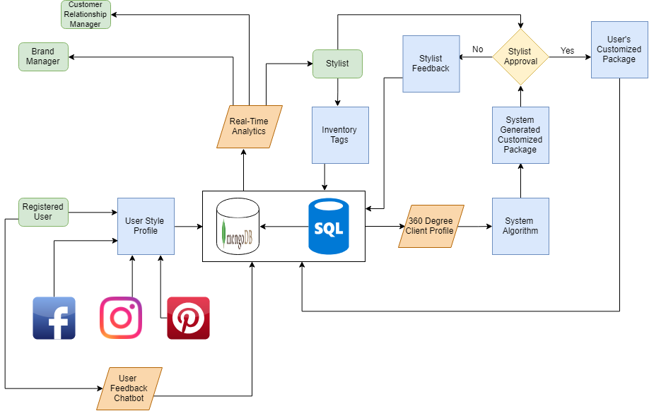
Our Proposed System
14
Notes:
Time: 3 min
Slide Type: Average
References:
14. Proposed System Flow Chart drawn using: https://www.draw.io/

Slide 13
Architecture
User
User Interface
Application Layer
Data Access
Database Layer
Shopper
Analyst
DB Admin
Style Mgr DBA
Brand Mgr
CRM Mgr
Style Profile UI
Chatbot UI
MongoDB UI
Analytics Module UI
360 degree Style Profile
System
Chatbot
System
Style Matching System Algorithm
Real-Time Analytics System
MySQL : Existing Data
MongoDB : New Unstructured Data
Notes:
Time: 3 mins
Slide Type: Average

Slide 14
Why MongoDB?
Notes:
Time: 30 sec
Slide Type: Transition

Slide 15
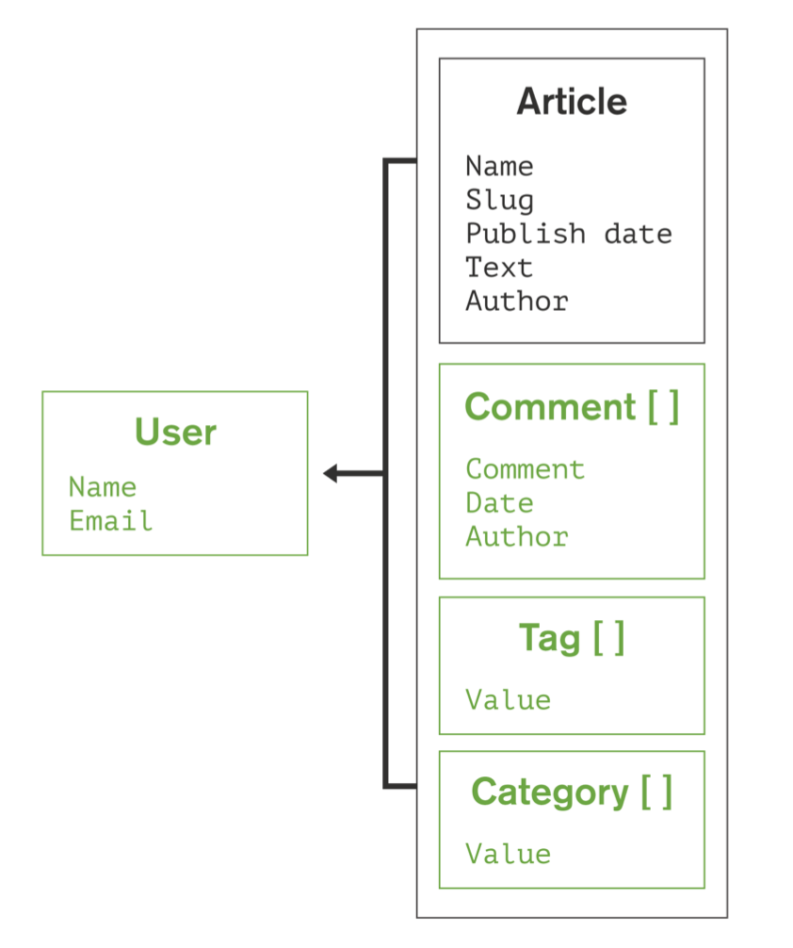
Why MongoDB suits us better?
Developer productivity is increased with JSON Documents:
Working with data as flexible JSON documents, rather than as rigid rows and columns, is proven to help developers move faster. With data for an entity stored in a single document, rather than spread across multiple relational tables, the database only needs to read and write to a single place. Having all the data for an object in one place also makes it easier for developers to understand and optimize query performance.
This feature would be critical to store our client’s unstructured data and create 360 degree client profiles, which would be enhanced by our prospective chatbot feature, as mondoDB has the capability to store Chatbot conversations with the client as documents linked to their 360 degree client profile
15
16
Notes:
Time: 3min
Slide Type: Average
References:
15. Deveoper productivity is increased with JSON Documents: https://www.mongodb.com/compare/mongodb-mysql
16. Document storage Image: https://jira.mongodb.org/secure/attachment/.../MongoDB_Architecture_Guide.pdf

Slide 16
Why MongoDB suits us better?
2. MySQL’s JSON data type does not bring the developer productivity benefits of a document database to MySQL:
Proprietary Extensions: Querying and manipulating the contents of a JSON document requires the use of separate MySQL-specific SQL functions to access values, which is not familiar to our developers. The MongoDB API is preferred by our team as it is adopted by industry standard tools and connectors
Legacy Relational Overhead: Even with JSON support, MySQL users are still tied to multiple layers of SQL/relational functionality to interact with JSON data – low level JDBC/ODBC drivers and Object Relational Mappers (ORMs). MongoDB drivers are implemented in the methods and functions that are idiomatic and natural to the programming languages used by developers
17
Notes:
Time: 3min
Slide Type: Average
References:
17. MySQL’s JSON data type does not bring the developer productivity: https://www.mongodb.com/compare/mongodb-mysql

Slide 17
Why MongoDB suits us better?
2. MySQL’s JSON data type does not bring the developer productivity benefits of a document database to MySQL:
Complex Data Handling: When using JSON data, MySQL drivers do not have the capability to properly and precisely convert JSON into a useful native data type used by the application. This includes different types of numeric values (e.g. floating points, 64-bit integers, decimals) timestamps, and dates, or a Map or List in Java or a Dictionary or List in Python. Binary Encoded JSON (BSON) used by MongoDB and its drivers supports advanced data types not supported by regular text-based JSON
No Data Governance: MySQL offers no native mechanism to validate the schema of JSON inserted or updated in the database, so developers need to add either application or database-side functionality to apply governance controls against the data. Schema validation, based on the JSON Schema IETF standard, allows developers and DBAs to define and enforce a prescribed schema structure for each MongoDB collection. This feature would help streamline data collected from our Chatbot module.
18
Notes:
Time: 3min
Slide Type: Average
References:
18. MySQL’s JSON data type does not bring the developer productivity: https://www.mongodb.com/compare/mongodb-mysql

Slide 18
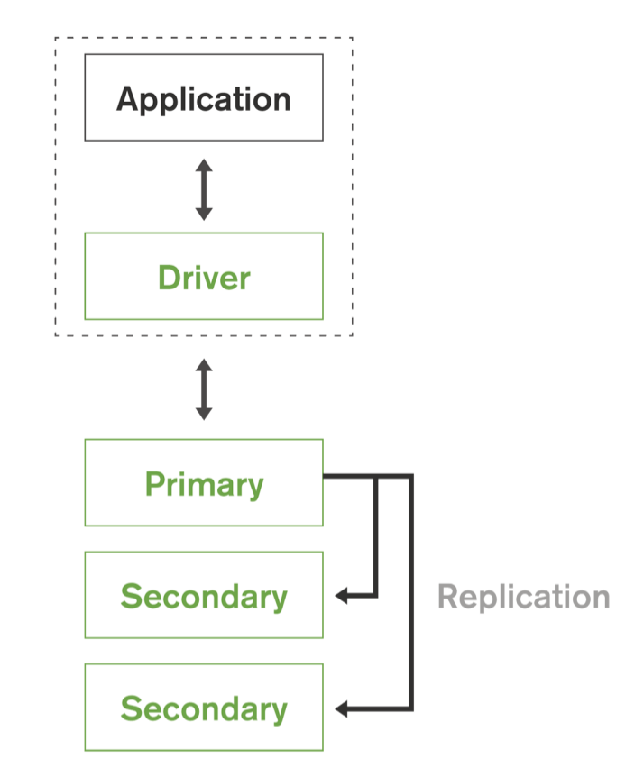
Why MongoDB suits us better?
19
3. MongoDB maintains multiple copies of data called replica sets using native replication:
A replica set is a fully self-healing shard that helps prevent database downtime and can be used to scale read operations. Replica failover is fully automated, eliminating the need for administrators to intervene manually.
This feature would be critical as we expect our clients to interact with our Chatbot at any time of the day and we have to ensure our Chatbot has access to client’s information at all times to provide a good experience and to collect their feedback coherently.
20
Notes:
Time: 3min
Slide Type: Average
References:
19. MongoDB maintains multiple copies of data: https://jira.mongodb.org/secure/attachment/.../MongoDB_Architecture_Guide.pdf
20. Replication Image: https://jira.mongodb.org/secure/attachment/.../MongoDB_Architecture_Guide.pdf

Slide 19
Why MongoDB suits us better?
21
4. Querying and Visualizing Data:
MongoDB is not limited to simple Key-Value operations. Developers can build rich applications using complex queries, aggregations and secondary indexes that unlock the value in structured, semi-structured and unstructured data, which would be invaluable to our business. A key element of this flexibility is MongoDB's support for many types of queries such as:
Key-value queries return results based on any field in the document, often the primary key
Range queries return results based on values defined as inequalities (e.g, greater than, less than or equal)
Geospatial queries return results based on proximity criteria, intersection and inclusion as specified by a point, line, circle or polygon
Text Search queries return results in relevance order based on text arguments using Boolean operators
Aggregation Framework queries return aggregations of values returned by the query (e.g., count, min, max, average, similar to a SQL GROUP BY statement). Through the $lookup stage, documents from separate collections can be combined through a left outer JOIN operation
MapReduce queries execute complex data processing that is expressed in JavaScript and executed across data in the database
Notes:
Time: 3min
Slide Type: Average
References:
21. Querying and Visualizing Data: https://jira.mongodb.org/secure/attachment/.../MongoDB_Architecture_Guide.pdf

Slide 20
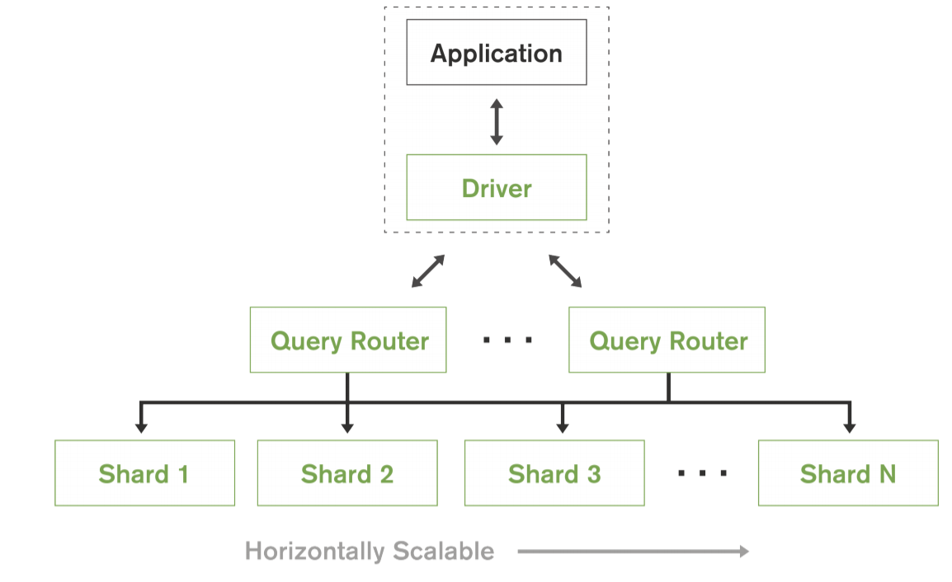
Why MongoDB suits us better?
22
5. Auto-Sharding :
MongoDB provides horizontal scale-out for databases on low cost, commodity hardware or cloud infrastructure using a technique called sharding, which is transparent to applications. Sharding distributes data across multiple physical partitions called shards. Sharding allows MongoDB deployments to address the hardware limitations of a single server, such as bottlenecks in RAM or disk I/O, without adding complexity to the application. MongoDB automatically balances the data in the sharded cluster as the data grows or the size of the cluster increases or decreases.
This feature is immensely helpful as StyleUp is still growing and we need to address scaling up as well as scaling down seamlessly
Notes:
Time: 5 min
Slide Type: Average
References:
22. Auto-Sharding: https://jira.mongodb.org/secure/attachment/.../MongoDB_Architecture_Guide.pdf

Slide 21
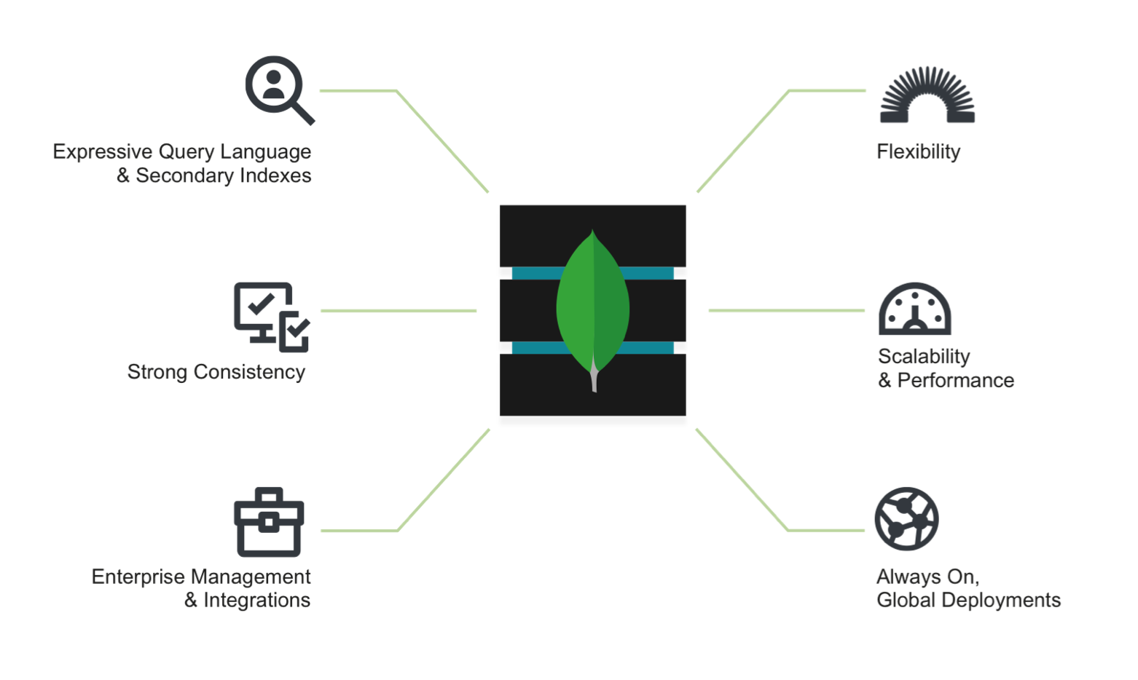
MongoDB Architecture
23
MongoDB Nexus Architecture, blending the best of relational and NoSQL technologies
Notes:
Time: 1min
Slide Type: Simple
References:
23. MongoDB Architecture: https://jira.mongodb.org/secure/attachment/.../MongoDB_Architecture_Guide.pdf

Slide 22
Expressive Query Language and Secondary Indexes
24
Users can access and manipulate their data to support both:
Operational applications: StyleUp creates custom orders based on our client’s style profile by leveraging our inventory-matching algorithm and inputs from stylists which requires expressive query language & secondary indexes capability of MongoDB to provide efficient access to data, supported natively by the database rather than maintained in application code.
Analytical applications: StyleUp can effectively leverage analytics by tapping into customer feedback obtained from our Chatbot module and review our brand collaborations, performance of our algorithm, monitor changing customer preferences. This requires complex querying enabled by MongoDB as our analytics combines various nuances
Notes:
Time: 5 min
Slide Type: Complex
References:
24. Expressive Query Language and Secondary Indexes: https://jira.mongodb.org/secure/attachment/.../MongoDB_Architecture_Guide.pdf

Slide 23
Strong Consistency
25
We can understand our customers better by immediately capturing changes in their style preferences. MongoDB enables StyleUp to immediately read and use data that has been written to the database. It reduces the complexity involved in building applications around an eventually consistent model.
Notes:
Time: 30 sec
Slide Type: Title
References:
25. Strong Consistency: https://jira.mongodb.org/secure/attachment/.../MongoDB_Architecture_Guide.pdf

Slide 24
Enterprise Management and Integrations
26
Databases are just one piece of application infrastructure. At StyleUp we require a database solution that fits seamlessly into the enterprise IT stack. MongoDB imposes requirements not addressed by relational databases like MySQL by offering
Flexible Data Model: Document, graph, key-value, or wide-column, all of them offer make it easy to store and combine data of any structure and allow dynamic modification of the schema without downtime or performance impact
Always-On Deployments: Designed to run across many nodes, including replication to automatically synchronize data across servers, racks, and data centers.
Scalability and Performance: Sharding or partitioning allows the database to scale out on commodity hardware deployed on-premises or in the cloud, enabling almost unlimited growth
Notes:
Time: 5 min
Slide Type:Complex
References:
26. Enterprise Management and Integrations: https://jira.mongodb.org/secure/attachment/.../MongoDB_Architecture_Guide.pdf

Slide 25




Upstream
Apache: For back-end GUI Support
Java: Allows creation of Javascript queries
MapReduce: Provides data aggregation capabilities
WiredTiger: The default WiredTiger storage engine for granular concurrency control and native compression will provide the best all round performance and storage efficiency for the broadest range of applications
29
30
27
28
Notes:
Time: 1 min
Slide Type: Simple
References:
27. Java Image: https://www.theverge.com/2016/1/28/10858250/oracle-java-plugin-deprecation-jdk-9
28. Mapreduce Image: https://medium.com/@tejasghalsasi/hadoop-101-getting-started-5d27e7210bb7
29. Wiredtiger Image: https://www.slideshare.net/wiredtiger/wired-tiger-overview3
30. Apache Image: https://www.g2crowd.com/products/apache-server/reviews

Slide 26

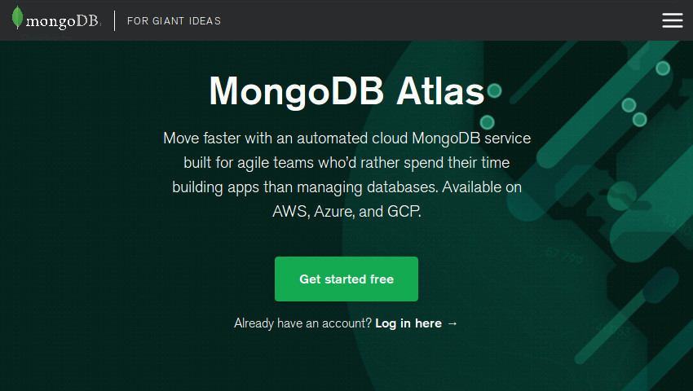

Downstream
33
31
32
Compass - Provides GUI support for data visualization, also API support for 3rd party management software
Atlas - Provides cloud support and management for a distributed virtualized shard deployment
Stitch - Back end support and integration for external applications along with API access, also provides application management services
Notes:
Time: 1 min
Slide Type: Simple
References:
31. Atlas: https://code.tutsplus.com/tutorials/create-a-database-cluster-in-the-cloud-with-mongodb-atlas--cms-31840
32. Compass: https://www.kenwalger.com/blog/nosql/mongodb/mongodb-compass-an-overview/
33. Stitch: https://medium.com/@nparsons08/mongodb-stitch-your-application-backend-delivered-as-a-service-7cf21d979ed

Slide 27
High-Level System Requirements
Notes:
Time: 30 sec
Slide Type: Transition

Slide 28
High-Level Requirements
Functional Requirements:
The system must integrate with the existing StyleUp MySQL Database
The system should have a maintained permissions file using MongoDB “Users and Roles” that is kept at parity with our MySQL database
The system should store all data in a document format as a binary representation called BSON (Binary JSON)
The system must refresh a client’s 360 degree style profile on demand
The system must support flexible schema design to support our dynamic data sources and data gathering techniques
The system should support document validation as Dynamic schemas bring great agility, but it is also important that controls can be implemented to maintain data quality and integrity
34
35
Notes:
Time: 3 min
Slide Type: Average
References:
34. Document format as a binary representation called BSON: https://jira.mongodb.org/secure/attachment/.../MongoDB_Architecture_Guide.pdf
35. Document validation as Dynamic schemas: https://jira.mongodb.org/secure/attachment/.../MongoDB_Architecture_Guide.pdf

Slide 29
High-Level Requirements
Functional Requirements:
The system should support the large volume of information collected from each client
The system should support varied data formats from chatbots conversation in DB such as pictures, text, GIFs, Video etc
The system should support key-value queries, range queries, geospatial queries, text search queries, aggregation framework queries and MapReduce queries
The system should be able to query and analyze each user interaction across full customer journey by using data to improve engagement and retention
The system should be able to schedule analytical reports to communicate business performance in terms of different metrics
36
Notes:
Time: 3 min
Slide Type: Average
References:
36. The system should support key-value queries..: https://jira.mongodb.org/secure/attachment/.../MongoDB_Architecture_Guide.pdf

Slide 30
High-Level Requirements
Non-Functional Requirements:
Performance:
The system must support support for many types of secondary indexes that can be declared on any field in the document,including fields within arrays to facilitate faster querying
The system must ensure no data lag longer than 15 minutes
The system must minimize data latency and optimum utilization of hardware resources
The system should monitor system metrics and send custom alerts before the system degrades
Scalability:
As our data is expected to grow exponentially the system must support it efficiently by sharding
The system must scale in line with scalability of hardware resources
The system should optimize in case of loss of business and should scale down effectively
37
37
Notes:
Time: 3 min
Slide Type: Average
References:
37. Performance and Scalability: https://jira.mongodb.org/secure/attachment/.../MongoDB_Architecture_Guide.pdf

Slide 31
High-Level Requirements
Non-Functional Requirements:
Recoverability:
The system should support Point-in-time, Scheduled Backups to restore complete running clusters to any point in time with just few clicks, because disasters aren't predictable
Concurrency:
The system should be able to support concurrent user queries
Security:
The system should simplifying access control to the database and should specify user-defined roles to enable administrators to configure granular permissions
The system should support data encryption on the network and on disk
38
38
Notes:
Time: 3 min
Slide Type: Average
References:
38.Recoverability and Security: https://jira.mongodb.org/secure/attachment/.../MongoDB_Architecture_Guide.pdf

Slide 32
High-Level Requirements
Non-Functional Requirements:
Usability:
The system interface should be easy to learn, navigate and, should not intimidate or overwhelm the user with its complexity.
System has to be designed in a way which will require minimal efforts from the users helping them to focus on achieving goals quickly with few or no errors.
Reliability:
The system should be able perform efficiently without any discrepancies in the result and should have no or minimal amount of downtime in case of catastrophic events.
Interoperability:
The system should have the capability to interact with third party applications and softwares.
Notes:
Time: 3 min
Slide Type: Average

Slide 33
Personas
Notes:
Time: 30 sec
Slide Type: Transition

Slide 34

Pam, the Homemaker
39
Qualities:
Mom of 2 and hence very busy
Loves Shopping
Fashion forward
Motivations:
Quality
Latest fashion trends
Value for money
Bio
Pam, 38 was a sales manager at Target, Los Angeles. She is a dedicated mom now who spends her entire day looking after her 3 year old daughter and two year old son. Hence she has very little time to go out and shop for herself or her kids. Her husband is a businessman who cannot spare much time for his family. Michelle is an avid shopper and is very much aware of the changing fashion trends. She loves to shop online.
Important Needs:
She needs a one stop shop
She needs to manage her changing size issues post pregnancy
She needs easy returns policies
Notes:
Time: 1min
Slide Type: Simple
References:
39. Homemaker Image: https://bit.ly/2UZCDaO

Slide 35

Ryan, the College Student
40
Qualities:
Ambitious
Adventurous and Athletic
Outgoing and Social
Motivations:
Comfort
Ease of buying
Value for money
Bio Ryan, 22 is a graduate student at CMU. He is a hardworking and determined student He loves to ride bikes and go on treks. He has a very active social life and loves partying. Also, he is the president of the international students foundation at CMU. He works on campus to cover his expenses.
Important Needs:
He needs to shop very frequently but does not want to travel for the same
He needs a variety of clothes for different events
He needs to buy clothes at an affordable price
Notes:
Time: 3min
Slide Type: Average
References:
40. College Student Image: https://bit.ly/2TY0Az6

Slide 36

Jim, Database Administrator
41
Qualities:
Passionate about new technologies
Great leadership skills
Motivations:
Contributing to StyleUp’s growth
Opportunity to demonstrate strong database management skills
Bio
Jim, 32 heads our Database Management Team. He is a Computer Engineer from Georgia Tech and is adept at implementing new technologies and his previous experience with McKinsey Project Management team has equipped him with transformation experience. He has strong leadership skills and enjoys taking up challenging projects. He has been instrumental in StyleUp’s growth so far.
Important Needs:
Cost-effective database that supports semi-structured and unstructured data
Auto-sharding to optimize and automate scaling operations given his small team size
Document based storage to support StyleUp’s Chatbot development and integration
Notes:
Time: 1min
Slide Type: Simple
References:
41. Database Administrator Image: https://bit.ly/2SW3I1h

Slide 37

Kelly, Style Manager DBA
42
Qualities:
Keen eye for detail
Quick learner and great communicator
Motivations:
Leverage her unique position as a mediator between DBA team and Stylists to improve StyleUp’s product proposition
Bio
Kelly, 26, a part of the DBA Team but mainly coordinates with the Stylists to implement their requirements in the Database and facilitates their needs. She is very passionate about the fashion industry and is very skilled at managing latest technologies and database applications.
Important Needs:
Wants to model the database to facilitate smooth flow of feedback from customers to Stylists
Minimize latency in the system to ensure timely reporting
Notes:
Time: 1min
Slide Type: Simple
References:
42. Style Manager Image: https://bit.ly/2tvXHKl

Slide 38

Meredith, Data Analyst
43
Qualities:
Passionate about data
Skilled in big data analytics and visualizations
Driven by her determination and curiosity to learn new advancements in technology
Motivations:
Make full use of the available data to generate meaningful insights for the executives so that they can make an informed decision.
Bio
Meredith, 25, is a Statistics graduate from NYU and has been with StyleUp since a year now. Meredith specializes in big data analysis and data visualization. She loves working in startups because of the nature of work which requires her to wear many hats. She believes she will learn more this way. Meredith’s determination and curiosity to learn new things has helped StyleUp immensely. She is definitely a valuable asset to our company because of her skills.
Important Needs:
Meredith wants to access the huge amount of historical data for studying consumer behavior and patterns to help the management make informed decisions, with minimum latency
Notes:
Time: 1min
Slide Type: Simple
References:
43. Data Analyst Image: https://bit.ly/2NhDzV6

Slide 39

Dwight, Brand Manager
44
Qualities:
Keen eye for detail
Great at foreseeing market trends
Motivations:
Ensure StyleUp collaborates with the most popular retail brands
Discover nascent brands which have great potential
Bio
Dwight, 35 has an MBA from The Kellogg School of Management at Northwestern University. Prior to StyleUp, he worked as a Retail Liaison Manager at Macy’s. He is responsible for StyleUp’s collaborations with different brands and we have benefited tremendously from his market knowledge, relationship with retailers and passion for delivering a fashion forward products.
Important Needs:
Understand our client’s brand preferences
Stay ahead of competition by collaborating with nascent brands which can cater to our client’s style profiles
Get frequent client feedback about brand performance
Notes:
Time: 1min
Slide Type: Simple
References:
44. Brand Manager Image: https://bit.ly/2Nh0Qqw

Slide 40

Toby, Customer Relationship Manager
45
Qualities:
Customer focused
Loves to talk to customers and helps them in solving their issues
Motivations:
Increase customer base, customer loyalty and retention
Bio
Toby, 42, is a customer relationship manager at StyleUp. His main responsibilities include increasing the customer base by grabbing all marketing opportunities. He is also responsible for customer retention and loyalty to increase lifetime of customers. He also develops testing strategies for all aspects of the CRM to ensure most effective approach for the company and its customers.
46
Important Needs:
He needs to access historical information efficiently to view the issues that his customers are facing to resolve them quickly
Wants a one-stop view of all information related to clients such as a 360 degree view
He wants to provide 24x7 customer support by implementing a chatbot
Notes:
Time: 1min
Slide Type: Simple
References:
45. Customer Relationship Manager Image: https://bit.ly/2V5RMXU
46. Customer Relationship Manager Bio: https://www.charterselection.com/marketing-job-descriptions/crm-manager-job-description

Slide 41
User Stories
And
Acceptance Tests
Notes:
Time: 30 sec
Slide Type: Transition

Slide 42
User Story by Database Administrator:
User Story | Acceptance Test
“As a database administrator, I want a database that supports semi-structured and unstructured data in a cost-efficient way, so that data can be organized as documents and not bulky tables .” | The database solution adopted should limit latency to no more than 3 seconds.
“As a database administrator, I want a database that supports auto-sharding, so that I can manage scaling operations with my small team .” | The database solution adopted should automatically balance the data in the sharded cluster as the data grows or the size of the cluster increases or decreases, without having to devote more resources to the DBA team.
Notes:
Time: 3 min
Slide Type: Average

Slide 43
User Story by Data Analyst:
User Story | Acceptance Test
“As a Data Analyst, I want a database that facilitates fast querying across different modules, so that I don’t have to spend time writing complex queries to gather data required for reporting on metrics.” | StyleUp should develop a dashboard that supports reporting on real-time customer behaviour metrics. The data should be updated real-time with no lag of more than 15 minutes.
“As a Data Analyst, I want a database that enables me to analyse customer feedback by storing Chatbot conversations in a document format , so that StyleUp’s management can use my insights to strategize.” | StyleUp should reduce their average grievance resolution time by at least 30%
Notes:
Time: 3 min
Slide Type: Average

Slide 44
User Story by Style Manager DBA:
User Story | Acceptance Test
“As a Style Manager DBA, I want a database that enables me to provide Stylists with a one-stop platform to get a 360 degree view of clients, so that they can understand clients better and customize their packages effectively.” | The 360 degree view should help StyleUp achieve return rates of 15% which is 5% below the online retail ecommerce market and it should increase package frequency and package volume by at least 20%
“As a Style Manager DBA, I want a database that enables me to give Stylists access to direct feedback from clients, so that they can adapt to their changing preferences and give them more of what they like.” | The Chatbot module resolve complaints and should enhance the 360 degree view further, resulting in repeat orders from at least 40% of the customers interacting with our Chatbot to give negative feedback.
Notes:
Time: 3 min
Slide Type: Average

Slide 45
User Story by Brand Manager:
User Story | Acceptance Test
“As a brand manager, I want to view current & historical customer feedback on all the brands, so that I can analyze the performance of each brand.” | The analytics module should help StyleUp to generate and analyze meaningful reports from historical data which would help the team to make informed decisions. This should help us achieve merchandise turnover rate of 3 vs industry average of 3.91
“As a brand manager, I want to make sure that I stay updated on customer’s preferred brands, so that I can try to include them as our brand partners if they’re not already.” | The analytics module should help StyleUp to generate meaningful reports on customer’s preferred brands, so that brand managers can take further steps to include those brands at StyleUp based on their demand and popularity. We should constantly phase out/review/substitute brands with merchandise turnover rate of more than 4.
Notes:
Time: 3 min
Slide Type: Average

Slide 46
User Story by Customer Relationship Manager:
User Story | Acceptance Test
“As a customer relationship manager, I want to see what common issues my customers have been facing, so that I can get my team to resolve them for improving customer satisfaction index.” | The analytics module which is to be included in StyleUp should help the CRM team to view the common and independant issues across all the customers so that they can be resolved quickly. This should help us improve our CSAT index by at least 25%
“As a customer relationship manager, I want my customers to have a medium to interact with us 24x7, so that we are able to help them faster with reduced response waiting time.” | The chatbot module in StyleUp should interact with the customers 24x7 and should generate tickets for the registered complaints so that the CRM team can resolve them in time. This should reduce the average grievance resolution time by at least 30%
Notes:
Time: 3 min
Slide Type: Average

Slide 47
Software Development Lifecycle Model
Notes:
Time: 30 sec
Slide Type: Transition

Slide 48
StyleUp Resources
Team of 75
Developers, Stylists, Brand Managers, Customer Support, HR, DB Team, Admin, Analysts, Product Managers
30 Developers
We have recently received Series A funding of $15 Million, out of which we plan to allocate 40% towards hiring 15 new developers, expand our Brand Liaisoning Team and bring in Instagram influencers to guide our team of Stylists
Notes:
Time: 1 min
Slide Type: Simple

Slide 49
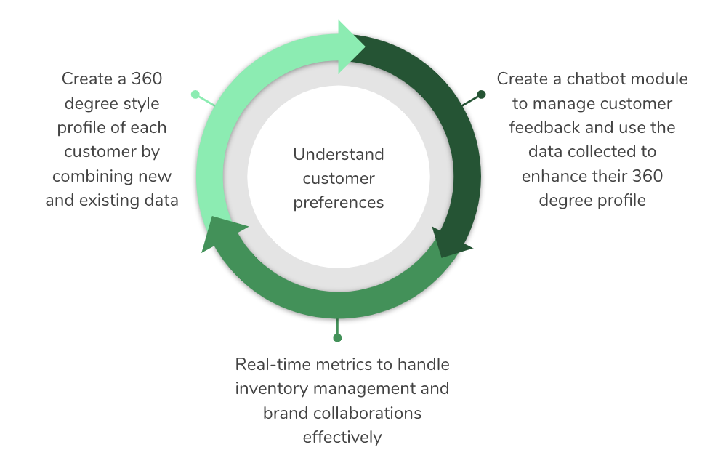
SDLC Model for StyleUp
StyleUp’s Proposed Changes involve implementing the following in the next 6 months:
Takeaway:
Action Plan can be modularized
We have one key feature underlying all 3 modules: Capturing unstructured data and storing it as a document
Notes:
Time: 1 min
Slide Type: Simple

Slide 50
SDLC Model for StyleUp
We believe that Rapid Application Development (RAD) along with Rockstar would be the most suitable SDLC Model for the following reasons:
We have 1 dominant Rockstar feature required: Capturing unstructured data and storing it as a document
We have 3 distinct modules which make RAD an ideal model:
360 degree client view to display all information (structured and unstructured) related to a client as a one-stop view
Chatbot module to manage customer feedback
Real-time Analytics to monitor different metrics
Since we plan to implement these new changes over a short span of 6 months, RAD would be appropriate since we can assign the three modules to different teams which can work to build them simultaneously
Given our recent funding allocation plan, we will have approximately $6 Million (40% of 15), to hire 15 developers and other domain experts which would facilitate allocating manpower resources to 3 RAD teams
Notes:
Time: 5 min
Slide Type: Complex

Slide 51
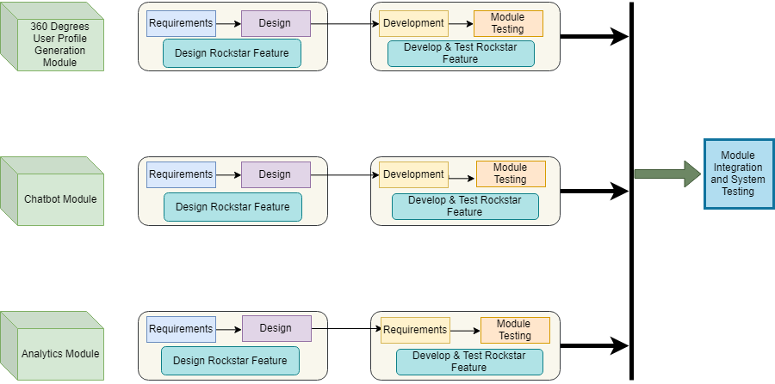
RAD and Rockstar SDLC Model:
46
Notes:
Time: 3 min
Slide Type: Average
References:
46. RAD and Rockstar SDLC Model Diagram drawn using: draw.io

Slide 52
Timeline and Milestones
Notes:
Time: 30 sec
Slide Type: Transition

Slide 53
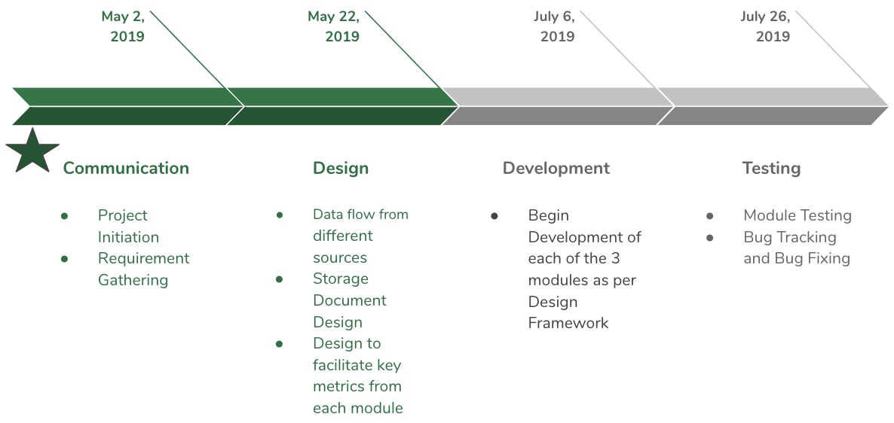
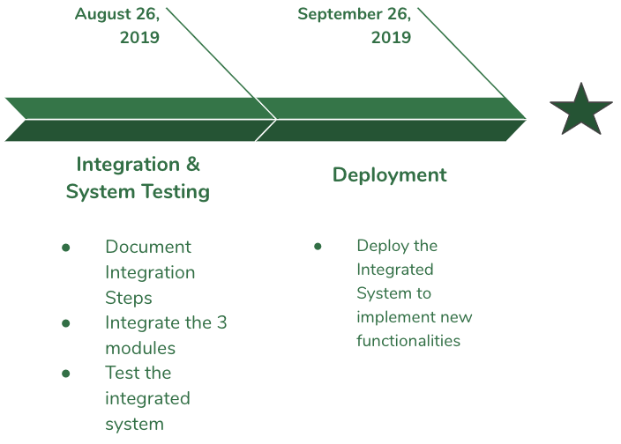
Timeline
VC Presentation
October 26, 2019
Start Date April 2, 2019
Each of the 3 modules are managed by 3 teams independently in line with the RAD Model
All the 3 Modules are Integrated and Deployed together
Notes:
Time: 1min
Slide Type: Simple

Slide 54
Key Areas to Focus
Notes:
Time: 30 sec
Slide Type: Transition

Slide 55
Key Focus Areas
Identify Risks at the requirements stage
Ensure the Rockstar feature takes precedence across all 3 modules
Since the project is implemented using RAD, involving 3 different teams, ensure that all the processes are well-documented
Ensure the legacy system (MySQL) is operational and isolated from the changes being implemented
Notes:
Time: 1 min
Slide Type: Simple

Slide 56
Risks & Mitigation
Notes:
Time: 30 sec
Slide Type: Transition:

Slide 57
Risk Table
Risks | Probability | Severity | Mitigation
Operational risk in moving to a new technology stack | High | High | Transition such that there is no user impact due to the migration by planning transition gradually and step-wise
Risk of data loss with relaxed DB consistency guarantees | Medium | High | Validate assumptions around data consistency
Resistance to change | Low | Medium | Employees should be given proper training and all employee concerns should be constantly addressed during development process
Notes:
Time: 1 min
Slide Type: Simple

Slide 58
Risk Table
Risk | Probability | Severity | Mitigation
Development resource constraints due to migration workload | High | Medium | Plan for staffing resource and commit all product feature related work to align with migration timelines
Bugs due to less static checking and tooling due to schema-less design | High | Medium | Evolve design practices around structured data to rely more on dynamic validation to ensure data integrity
Change in performance characteristics due to DB migration | Medium | High | Conducting performance drills and load tests to ensure performance is on par or better than MySQL. Ensuring querying patterns are optimized for MongoDB
Notes:
Time: 1 min
Slide Type: Simple

Slide 59
Risk Table
Risk | Probability | Severity | Mitigation
Securing customer data | Medium | High | Review auditing/feedback business process to properly secure customer data Protect against customer data scraping by setting monitoring Encrypting customer sensitive data
Notes:
Time: 1 min
Slide Type: Simple

Slide 60
Business Value & Success Metrics
Notes:
Time: 30 sec
Slide Type: Transition

Slide 61
Business Value
Reduce shipping costs on account of fewer returns
Understand customer preferences
Better control over performance metrics
Efficient brand management
Increase in Revenue on account of better customer service
Notes:
Time: 1 min
Slide Type: Simple

Slide 62
Success Metrics
Shipping Costs reduced by at least 25%
Maintain a return rate of 15% which is 5% below the online retail ecommerce market
Database solution adopted should limit latency to no more than 3 seconds
Average package frequency should increase by 20%
Average package volume should increase by 20%
Repeat orders from at least 40% of the customers interacting with our Chatbot to give negative feedback
Merchandise turnover rate of 3 (months) vs industry average of 3.91 (months)
Improve our CSAT index by at least 25%
Reduce the average grievance resolution time by at least 30%
Notes:
Time: 1 min
Slide Type: Simple

Slide 63
References
Notes:
Time: 30 sec
Slide Type: Transition

Slide 64
References
1. Mission Statement: https://www.stitchfix.com/about (Slide 3)
2. Confused Shopper Image: https://bit.ly/2TVZ4gW (Slide 5)
3. Survey Image: https://bit.ly/2TWxJv1 (Slide 5)
4. Delivery Person Image: https://bit.ly/2BH3gKa (Slide 5)
5. Happy Shopper Image: https://bit.ly/2EgRecs (Slide 5)
6. Brands Image: https://bit.ly/2GvsjUT (Slide 6)
7. Diverse Shoppers Image: https://bit.ly/2DUcx1S (Slide 6)
8. Growth Image: https://bit.ly/2towo4C (Slide 7)
9. Existing System Flowchart drawn using: https://www.draw.io/ (Slide 8)
10. Overwhelmed Person Image: https://bit.ly/2TVjN4B (Slide 9)
11. MySQL Oracle owned, not community driven: https://smartbear.com/blog/test-and-monitor/5-reasons-its-time-to-ditch-mysql/ (Slide 9)
12. MySQL Scalability issue: https://www.gridgain.com/resources/blog/5-limitations-mysql-big-data (Slide 9)
13. Features of MongoDB: https://docs.mongodb.com/manual/introduction/ (Slide 11)
14. Proposed System Flow Chart drawn using: https://www.draw.io/ (Slide 12)
15. Developer productivity is increased with JSON Documents: https://www.mongodb.com/compare/mongodb-mysql (Slide 15)
16. Document storage Image: https://jira.mongodb.org/secure/attachment/.../MongoDB_Architecture_Guide.pdf (Slide 15)
Notes:
Time: 30 sec
Slide Type: Transition

Slide 65
References
17. MySQL’s JSON data type does not bring the developer productivity: https://www.mongodb.com/compare/mongodb-mysql (Slide 16)
18. MySQL’s JSON data type does not bring the developer productivity: https://www.mongodb.com/compare/mongodb-mysql (Slide 17)
19. MongoDB maintains multiple copies of data: https://jira.mongodb.org/secure/attachment/.../MongoDB_Architecture_Guide.pdf (Slide 18)
20. Replication Image: https://jira.mongodb.org/secure/attachment/.../MongoDB_Architecture_Guide.pdf (Slide 18)
21. Querying and Visualizing Data: https://jira.mongodb.org/secure/attachment/.../MongoDB_Architecture_Guide.pdf (Slide 19)
22. Auto-Sharding: https://jira.mongodb.org/secure/attachment/.../MongoDB_Architecture_Guide.pdf (Slide 20)
23. MongoDB Architecture: https://jira.mongodb.org/secure/attachment/.../MongoDB_Architecture_Guide.pdf (Slide 21)
24. Expressive Query Language and Secondary Indexes: https://jira.mongodb.org/secure/attachment/.../MongoDB_Architecture_Guide.pdf (Slide 22)
25. Strong Consistency: https://jira.mongodb.org/secure/attachment/.../MongoDB_Architecture_Guide.pdf (Slide 23)
26. Enterprise Management and Integrations: https://jira.mongodb.org/secure/attachment/.../MongoDB_Architecture_Guide.pdf (Slide 24)
Notes:
Time: 30 sec
Slide Type: Transition

Slide 66
References
27. Java Image: https://www.theverge.com/2016/1/28/10858250/oracle-java-plugin-deprecation-jdk-9 (Slide 25)
28. Mapreduce Image: https://medium.com/@tejasghalsasi/hadoop-101-getting-started-5d27e7210bb7 (Slide 25)
29. Wiredtiger Image: https://www.slideshare.net/wiredtiger/wired-tiger-overview3 (Slide 25)
31. Atlas: https://code.tutsplus.com/tutorials/create-a-database-cluster-in-the-cloud-with-mongodb-atlas--cms-31840 (Slide 26)
32. Compass: https://www.kenwalger.com/blog/nosql/mongodb/mongodb-compass-an-overview/ (Slide 26)
33. Stitch: https://medium.com/@nparsons08/mongodb-stitch-your-application-backend-delivered-as-a-service-7cf21d979ed (Slide 26)
34. Document format as a binary representation called BSON: https://jira.mongodb.org/secure/attachment/.../MongoDB_Architecture_Guide.pdf (Slide 28)
35. Document validation as Dynamic schemas: https://jira.mongodb.org/secure/attachment/.../MongoDB_Architecture_Guide.pdf (Slide 28)
36. The system should support key-value queries..: https://jira.mongodb.org/secure/attachment/.../MongoDB_Architecture_Guide.pdf (Slide 29)
Notes:
Time: 30 sec
Slide Type: Transition

Slide 67
References
37. Performance and Scalability: https://jira.mongodb.org/secure/attachment/.../MongoDB_Architecture_Guide.pdf (Slide 30)
38.Recoverability and Security: https://jira.mongodb.org/secure/attachment/.../MongoDB_Architecture_Guide.pdf (Slide 31)
39. Homemaker Image: https://bit.ly/2UZCDaO (Slide 34)
40. College Student Image: https://bit.ly/2TY0Az6 (Slide 35)
41. Database Administrator Image: https://bit.ly/2SW3I1h (Slide 36)
42. Style Manager Image: https://bit.ly/2tvXHKl(Slide 37)
43. Data Analyst Image: https://bit.ly/2NhDzV6 (Slide 38)
44. Customer Relationship Manager Image: https://bit.ly/2V5RMXU (Slide 39)
45. Customer Relationship Manager Bio: https://www.charterselection.com/marketing-job-descriptions/crm-manager-job-description (Slide 40)
46. RAD and Rockstar SDLC Model Diagram drawn using: draw.io (Slide 53)
Notes:
Time: 30 sec
Slide Type: Transition

Slide 68
Backup Slides
Notes:
Time: 30 sec
Slide Type: Transition

Slide 69
May 2, 2019
May 22, 2019
July 6, 2019
July 26, 2019
Communication
Design
Development
Testing
Project Initiation
Requirement Gathering
Data flow from different sources
Storage Document Design
Design to facilitate key metrics from each module
Begin Development of each of the 3 modules as per Design Framework
Module Testing
Bug Tracking and Bug Fixing
Notes:
Time: 0 min
Slide Type: Backup
Requirement gathering 1 month
Design 20 days
Development 1.5 months
Testing 20 days
Integration 1 month
Deployment 1 month

Slide 70
August 26, 2019
September 26, 2019
Deployment
Integration & System Testing
Document Integration Steps
Integrate the 3 modules
Test the integrated system
Deploy the Integrated System to implement new functionalities
Notes:
Time: 0 min
Slide Type: Backup

Slide 71
Thank You!
Notes:
Time: 30 sec
Slide Type: Transition

Slide 72
Develop test plan - would it vary with your sdlc model? Be consistent (A/B testing validation category)
Write verification and validation requirements and acceptance criteria -Important
Decompose the user stories and acceptance tests further to single functionality
Maintain quantifiable values and figures in acceptance tests and user stories

